Slide 1
Representing Information (2)

Slide 2
Outline
Encodings
Unsigned and two’s complement
Suggested reading
Chap 2.2

Slide 3
Unsigned Representation
Binary (physical)
Bit vector [x_{w-1},x_{w-2},x_{w-3},…x₀]
Binary to Unsigned (logical)

Slide 4
Two’s Complement
Binary (physical)
Bit vector [x_{w-1},x_{w-2},x_{w-3},…x₀]
Binary to Signed (logical)
2’s complement(二进制补码)
Sign
Bit(符号位)

Slide 5
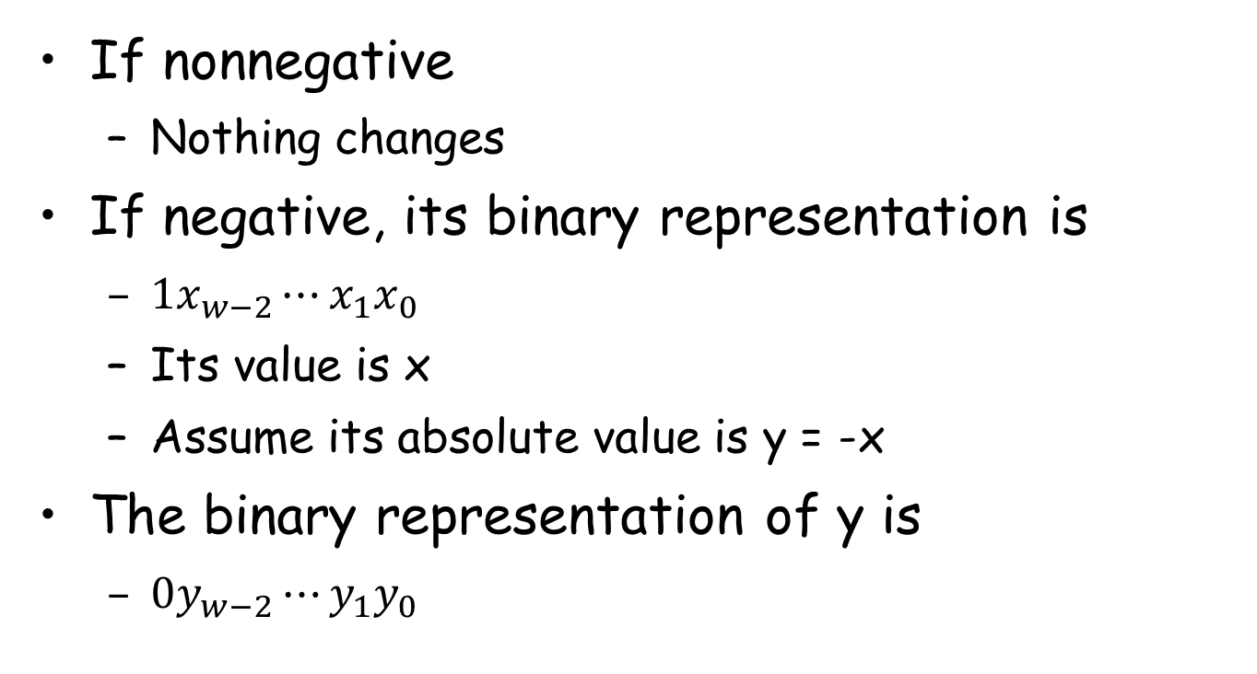
From Two’s Complement to Binary

Slide 6
Two’s Complement
Binary (physical)
Bit vector [x_{w-1},x_{w-2},x_{w-3},…x₀]
Binary to Signed (logical)
2’s complement
Sign
Bit

Slide 7
From Two’s Complement to Binary
(~y)
-x = ~x + 1

Slide 8
Two’s Complement
What does it mean?
Computing the negation of x into binary with w-bits
Complementing the result
Adding 1

Slide 9
From a Number to Two’s Complement
-5
5
0101 (binary for 5)
1010 (after complement)
1011 (add 1)

Slide 10
Two’s Complement Encoding Examples
Binary/Hexadecimal Representation for -12345
Binary: 0011 0000 0011 1001 (12345)
Hex: 3 0 3 9
Binary: 1100 1111 1100 0110 (after complement)
Hex: C F C 6
Binary: 1100 1111 1100 0111 (add 1)
Hex: C F C 7

Slide 11
Numeric Range
Unsigned Values
Umin=0
Umax=2^{w}-1
Two’s Complement Values
Tmin = -2^{w-1}
Tmax = 2^{w-1}-1

Slide 12
Numeric Range
Relationship
|TMin| = TMax + 1
Umax = 2*TMax + 1
-1 has the same bit representation as Umax,
a string of all 1s
Numeric value 0 is represented as
a string of all 0s in both representations

Slide 13
Alternative representations of signed numbers
Ones’ Complement: (反码)
The most significant bit has weight 2^{w-1}-1
Sign-Magnitude
The most significant bit is a sign bit
that determines whether the remaining bits should be given negative or positive weight

Slide 14
X
B2U(X)
B2T(X)
0000
0
0
0001
1
1
0010
2
2
0011
3
3
0100
4
4
0101
5
5
0110
6
6
0111
7
7
1000
8
–8
1001
9
–7
1010
10
–6
1011
11
–5
1100
12
–4
1101
13
–3
1110
14
–2
1111
15
–1

Slide 15
Mappings between logical and physical
Uniqueness
Every bit pattern represents unique integer value
Each representable integer has unique bit encoding

Slide 16
Mappings between logical and physical
Invert Mappings (from logical to physical)
U2B(x) = B2U⁻¹(x)
Bit pattern for unsigned integer
T2B(x) = B2T⁻¹(x)
Bit pattern for two’s comp integer

Slide 17
Relation Between 2’s Comp. & Unsigned
Two’s Complement
T2U
Unsigned
x
T2B
B2U
ux
X
Maintain Same Bit Pattern
w–1
0
ux
+
+
+
• • •
+
+
+
-
x
-
+
+
• • •
+
+
+
+2^{w–1} – –2^{w–1} = 2*2^{w–1} = 2^{w}

Slide 18
Conversion between two Representations
UMax
UMax – 1
TMax + 1
Unsigned
Range
TMax
TMax
2’s Comp.
Range
0
0
–1
–2
TMin

Slide 19
Casting among Integral Data Type

Slide 20
Outline
Conversions
Signed vs. unsigned
Long vs. short
Suggested reading
Chap 2.2

Slide 21
Integral data type in C
Signed type (for integer numbers)
char, short [int], int, long [int]
Unsigned type (for nonnegative numbers)
unsigned char, unsigned short [int], unsigned [int], unsigned long [int]
Java has no unsigned data type
Using byte to replace the char

Slide 22
Typical Ranges for C integral data types 32
C declaration | Typical 32-bit
 | minimum | maximum
char unsigned char | -128 0 | 127 255
short [int] unsigned short | -32,768 0 | 32,767 65,535
int unsigned [int] | -2,147,483,648 0 | 2,147,483,647 4,294,967,295
long [int] unsigned long | -2,147,483,648 0 | 2,147,483,647 4,294,967,295
int32_t uint32_t | -2,147,483,648 0 | 2,147,483,647 4,294,967,295
int64_t uint64_t | -9,223,372,036,854,775,800 0 | 9,223,372,036,854,775,800 18,446,744,073,709,551,615

Slide 23
Typical Ranges for C integral data types 64
C declaration | Typical 32-bit
 | minimum | maximum
char unsigned char | -128 0 | 127 255
short [int] unsigned short | -32,768 0 | 32,767 65,535
int unsigned [int] | -2,147,483,648 0 | 2,147,483,647 4,294,967,295
long [int] unsigned long | -9,223,372,036,854,775,800 0 | 9,223,372,036,854,775,800 18,446,744,073,709,551,615
int32_t uint32_t | -2,147,483,648 0 | 2,147,483,647 4,294,967,295
int64_t uint64_t | -9,223,372,036,854,775,800 0 | 9,223,372,036,854,775,800 18,446,744,073,709,551,615

Slide 24
Guaranteed Ranges for C integral data types
C declaration | Typical 32-bit
 | minimum | maximum
char unsigned char | -127 0 | 127 255
short [int] unsigned short | -32,767 0 | 32,767 65,535
int unsigned [int] | -32,767 0 | 32,767 65,535
long [int] unsigned long | -2,147,483,648 0 | 2,147,483,647 4,294,967,295
int32_t uint32_t | -2,147,483,648 0 | 2,147,483,647 4,294,967,295
int64_t uint64_t | -9,223,372,036,854,775,800 0 | 9,223,372,036,854,775,800 18,446,744,073,709,551,615

Slide 25
Casting among Signed and Unsigned in C
C Allows a variable of one type to be interpreted as other data type
Type conversion (implicitly)(隐式)
Type casting (explicitly)(显式)

Slide 26
Signed vs. Unsigned in C
Casting
Explicit casting between signed & unsigned
same as U2T and T2U
int tx, ty;
unsigned ux, uy;
tx = (int) ux;(显式类型转化)
uy = (unsigned) ty;

Slide 27
Signed vs. Unsigned in C
Conversion
Implicit casting also occurs via assignments and procedure calls
int tx, ty;
unsigned ux, uy;
tx = ux;(隐式类型转化)
uy = ty;

Slide 28
Casting from Signed to Unsigned
short int x = 12345;
unsigned short int ux = (unsigned short) x;
short int y = -12345;
unsigned short int uy = (unsigned short) y;
Resulting Value
No change in bit representation
Nonnegative values unchanged
ux = 12345
Negative values change into (large) positive values
uy = 53191

Slide 29
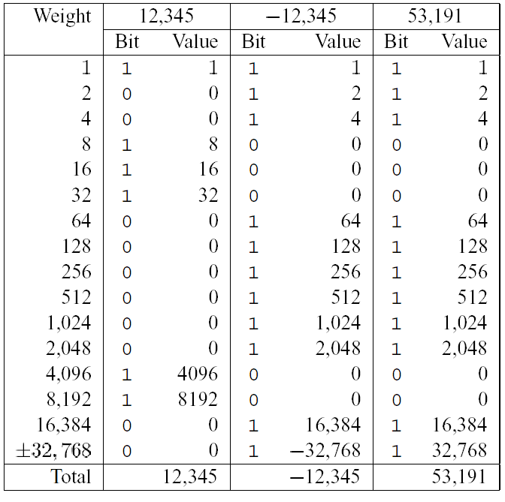
back

Slide 30
Unsigned Constants in C
By default
constants are considered to be signed integers
(常量被认为是signed类型)
Unsigned if have “U” as suffix(后缀)
0U, 4294967259U

Slide 31
Casting Convention
Expression Evaluation
If mix unsigned and signed in single expression
signed values implicitly cast to unsigned(同时存在signed和unsigned是默认全部隐式转化为unsigned。)
Including comparison operations <, >, ==, <=, >=
Examples for W = 32

Slide 32
Casting Convention
Constant1 Constant2 Relation Evaluation
0 0U == unsigned
-1 0 < signed
-1 0U > unsigned
2147483647 -2147483648 > signed
2147483647U -2147483648 < unsigned
-1 -2 > signed
(unsigned)-1 -2 > unsigned
(隐式变为u)

Slide 33
From short to long
short int x = 12345;
int ix = (int) x;
short int y = -12345;
int iy = (int) y;
We need to expand the data size
Casting among unsigned types is normal
Casing among signed types is trick

Slide 34
Expanding the Bit Representation
Zero extension(unsigned 类型)
Add leading 0s to the representation
Sign extension(signed 类型)
[x_{w-1},x_{w-2},x_{w-3},…x₀]
w
X
• • •
X
-
• • •
• • •
X ′
X ′
• • •
• • •
-
+
• • •
w+1
目的：保持变换后值不变

Slide 35
From short to long
short int sx = 12345; ：0x0309
int x = (int) sx; : 0x00000309
short int sy =-12345;: 0xcfc7
int y = (int) sy; : 0xffffcfc7
usinged ux = sy; : 0xffffcfc7

Slide 36
From short to long
int fun1(unsigned word) {
return (int) ((word << 24) >> 24);
}
int fun2(unsigned word) {
return ((int) word << 24) >> 24;
}
w fun1(w) fun2(w)
0x00000076
0x87654321
0x000000C9
0xEDCBA987
Describe in words the useful computation each of these functions performs.
unsigned >>:补0
signed >> :补符号位
00000076 00000076
00000021 00000021
000000C9 FFFFFFC9
00000087 FFFFFF87

Slide 37
From long to short
int x = 53191;
short int sx = x;
int y = -12345;
Short int sy = y;
We need to truncate(截断/短) the data size
Casing from long to short is trick

Slide 38
Truncating Numbers(signed unsigned都是直接截)
 | Decimal | Hex | Binary
x | 53191 | 00 00 CF C7 | 00000000 00000000 11001111 11000111
sx | -12345 | CF C7 | 11001111 11000111
y | -12345 | FF FF CF C7 | 11111111 11111111 11001111 11000111
sy | -12345 | CF C7 | 11001111 11000111
X ′
• • •
• • •
X
• • •

Slide 39
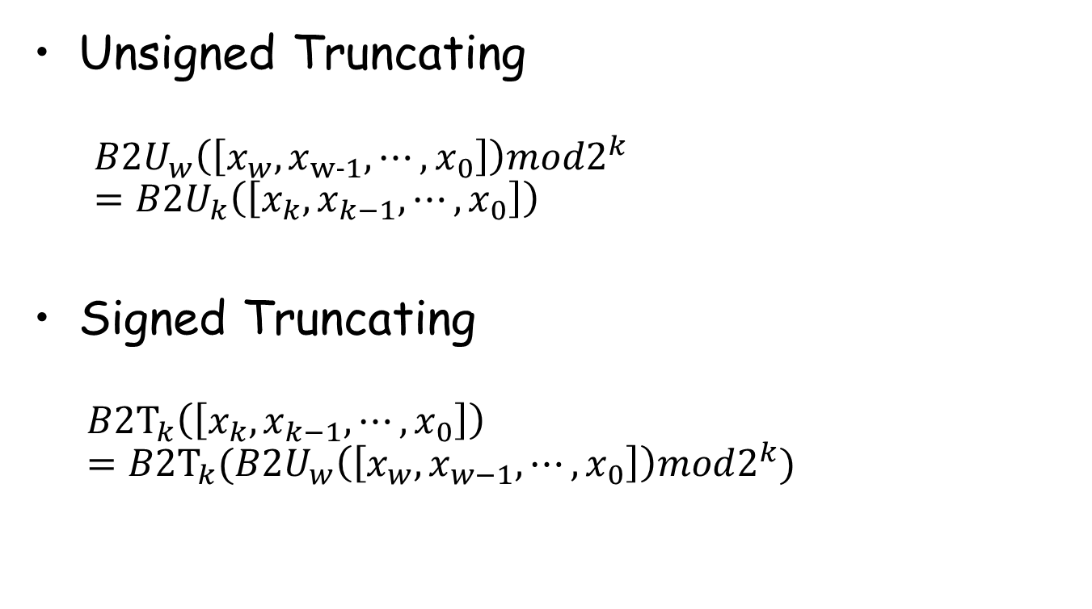
Truncating Numbers

Slide 40
Advice on Signed vs. Unsigned
Non-intuitive Features
float sum_elements ( float a[], unsigned length )
{
int i ;
for ( i = 0; i <= length – 1; i++)
result += a[i] ;
}
bug:unsigend 没有负数，若length=0，则循环会进行2^32-1次，最终越界崩溃

Slide 41
Advice on Signed vs. Unsigned
/* Prototype for library function strlen */
size_t strlen(const char *s); /*size_t is usigned */
/* Determine whether string s is longer than string t */
/* WARNING: This function is buggy */
int strlonger(char *s, char *t) {
return strlen(s) - strlen(t) > 0;
(return strlen(s) > strlen(t);)
}
提醒：一定注意引用的函数的各个参数的具体类型

Slide 42
Advice on Signed vs. Unsigned
1 /*
2 * Illustration of code vulnerability similar to that found in
3 * FreeBSD’s implementation of getpeername()
4 */
5
6 /* Declaration of library function memcpy */
7 void *memcpy(void *dest, void *src, size_t n);
8

Slide 43
Advice on Signed vs. Unsigned
9 /* Kernel memory region holding user-accessible data */
10 #define KSIZE 1024
11 char kbuf[KSIZE];
12
13 /* Copy at most maxlen bytes from kernel region to user buffer */
14 int copy_from_kernel(void *user_dest, int maxlen) {
15 /* Byte count len is minimum of buffer size and maxlen */
16 int len = KSIZE < maxlen ? KSIZE : maxlen;
17 memcpy(user_dest, kbuf, len);
18 return len;
19 }
Invoking(调用) copy_from_kernel() with a negative maxlen

Slide 44
Advice on Signed vs. Unsigned
Collections of bits
Bit vectors
Masks(掩码操作)
Addresses
Multiprecision Arithmetic(需要用到一些数学库)
Numbers are represented by arrays of words

